Slide 1


Carrier Guidance

Slide 2

Team Name: Bytecode Blasters Team Members: Sandeep Kumar Amarkant Gupta Saumyarani S Naveen Varma Bexel O J

Slide 3
Project Description
Career Guidance provides an automated online platform where students can get real online guide on their future careers and subjects choices and combinations that will help them realize their dreams.

Slide 4
Advantages:
Easy Accessibility:
User has the leverage to choose the carrier option in the provided list of carrier choices.
User Friendly:
User has to register to the Career Guidance by providing the personal details.
User can choose their area of interest and get the Job details, Eligibility criteria and Competitive exam details.

Slide 5
Structure of the Project:
User Input
1) New User
2) Existing User
Entering Details for a New User
1) Enter First Name
2) Enter Last Name
3) Enter Email ID
4) Enter Mobile Number
5) Enter Qualification
For Existing User
Enter Email ID
Enter Password
(Validation)
Details of the Specific Area
Enter Area of Interest
1) Engineering
2) Banking
3) Medical
4) Railway Job
5) SSC
6) UPSC

Slide 6
Inputs
Please select an option from the below
1) Existing user
2) New User
Enter the First Name: Amarkant
Enter the Last Name: Gupta
Enter the Email ID: amarkanth@gmail.com
Enter the Password: Career@123
Enter the Mobile Number: 9988456789
Enter the Qualification: 10th
Enter area of interest:
1) Engineering
2) Banking Job
3) Medical
4) Railway Job
5) SSC
6) UPSC

Slide 7
Additional Validations
1. Email
It should start with string [A-Za-z0-9-\]
It should contain at least one lowercase letter(a-z), one uppercase letter(A-Z) and one special character( @, #, %, &, !, $, etc.)
2. Password
It should not contain any space.
It should contain at least one digit(0-9), length [8 ~ 15], at least one lowercase letter(a-z) and one uppercase letter (A-Z) and special character ( @, #, %, &, !, $, etc.)
3. Mobile Number
It should start with numbers between 7 to 9
It should not be more than 10 digits
It can start with 0 and 91

Slide 8
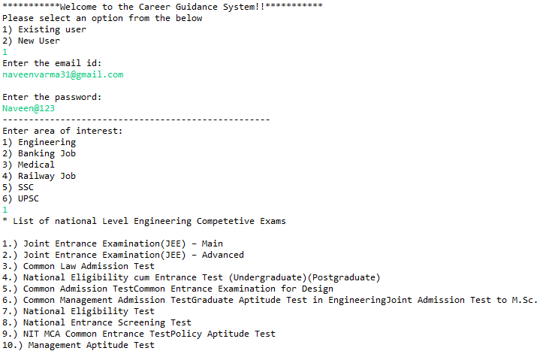
Output
1. Existing User

Slide 9
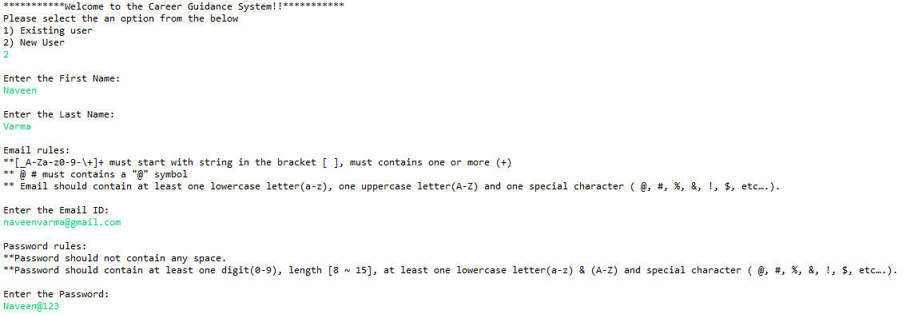
Output
2. New User
Contd..

Slide 10
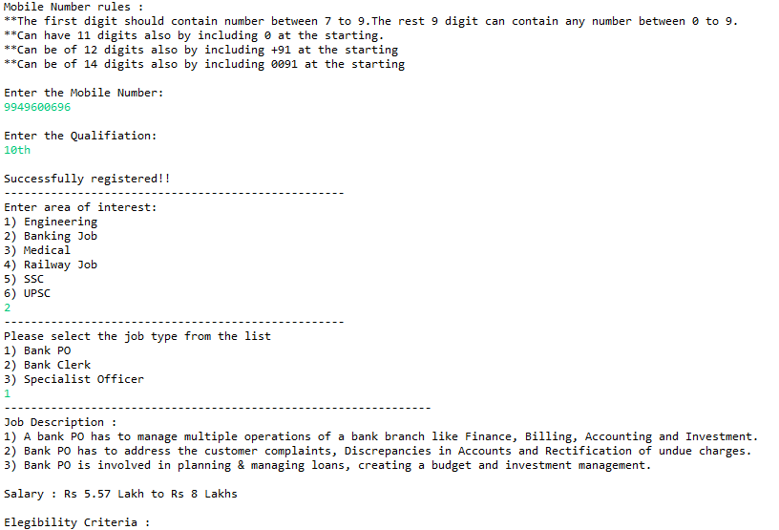
Output
2. New User
Contd..

Slide 11
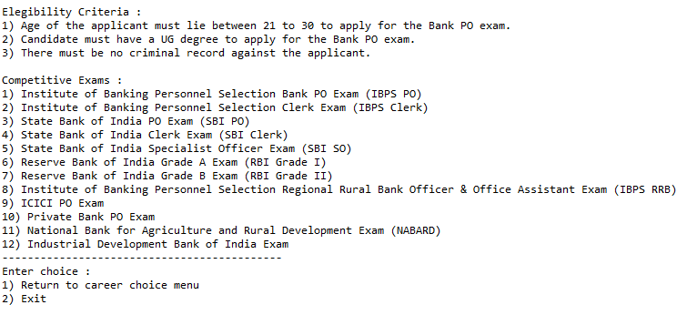
Output
2. New User

Slide 12


